Slide 1
Mortality in Local Jails, 2000-2007
Margaret Noonan
Statistician
Bureau of Justice Statistics
Deaths in Custody Reporting Program

Slide 2
Deaths in Custody Reporting Program (DCRP)
Started in 2000 after the passage of the Deaths in Custody Reporting Act.
  Jails (2000) –directly from the jurisdiction
  Prisons (2001) – from the DOC
  In the process of arrest (2003)
All DOCs participate and nearly 99% of jails participate.

Slide 3
DCRP-Mortality in Local Jails
8 year study period
  Nearly three years in the making
  Data sources from the DCRP, the CDC, the Annual Survey of Jails
  The aim of the study was to give a comprehensive view of jail mortality
The study sought to explain who, what, when and where of jail mortality

Slide 4
DCRP Mortality: Overview (What?)
About 1,000 inmates die in jails in the United States in any given year, or a total of 8,097
Most inmates do their time in jails without incident
80% of jails report zero deaths in any given year.
Most preventable deaths (intox, accident, homicide suicide) are uncommon in correctional facilities.
  75% of jails reported zero suicides in any given year
  18% of jails reported one or more homicides for the entire period
Of those inmates who die, the majority die by suicide (29%) or heart disease (22%)
Outside of these two causes, no other cause of death accounted for more than 7% of deaths (intoxication)

Slide 5
DCRP Mortality: Who dies?
Male and female inmates die at approximately equal rates (146 v. 136), but the number of males dying far outnumbers the number of females.
Men are more likely to die by suicide, whereas females are twice as likely to die due to an intoxication event.
Whites died at a higher rate than black and Hispanics – the suicide effect
Hispanics had lower death rates due to an illness event

Slide 6
DCRP Mortality: Who Dies, cont.
Blacks had the lowest suicide rates. Hispanics committed suicide at rate twice that of Blacks and Whites committed suicide at a rate four times that of Blacks.
Unconvicted inmates were twice as likely to die than convicted inmates
  Biggest gap seen in suicides (more than 3x for unconvicted)
The oldest inmates had the highest mortality rates (893 per 100,000) and were most likely to die of an illness-related event.
  358 per 100,000: Heart disease

Slide 7
DCRP Mortality: Profile
The typical death in jails is a white male, between the ages of 45 and 54, unconvicted at the time of his death, but charged with a violent offense who committed suicide.
Suicides are the leading cause of death in local jails, but continue a long-term decline.
Suicide rate in local jails in 1983: 129 per 100,000.
Suicide rate in local jails in 2007: 36 per 100,000.

Slide 8
DCRP Mortality: When?
The majority of jail inmates (62%) serve less than 7 days.
Nearly one-quarter (24%) of jail deaths occur within the first two days of admission.
More than one-third (38%) of jail deaths occur in the same time period.
  Nearly ¾ (74%) of intoxication deaths
  Half of accidents (51%)
  Nearly ½ (47%) of suicides

Slide 9
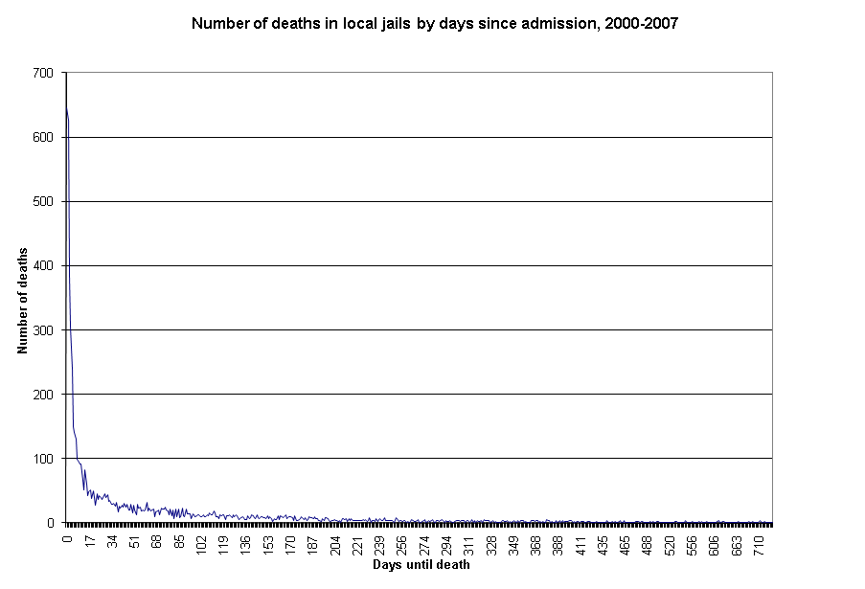
DCRP Mortality: When?

Slide 10
DCRP Mortality: Where?
The largest jails (ADP of 1,000+) accounted for about half of deaths (52%).
The largest jails account for 6% of all jails in the U.S. and about half of the jail population.
Jails holding 50 or fewer inmates accounted for 40% of jails, and 3% of the jail population.
The smallest jails had the highest mortality rate (282 per 100,000).
The largest jails (50 largest jail jurisdictions) had a mortality rate of 170 per 100,00.

Slide 11
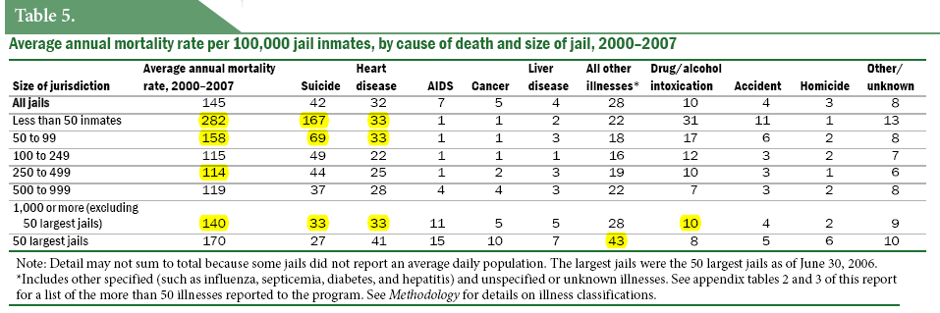
DCRP Mortality: Where (cont.)?
Cause of death varied by the size of jail jurisdiction.

Slide 12
DCRP Mortality: Where (cont.)?
Function of budget, the population served, the services provided, turnover and the capacity of jails to provide services.
The smallest facilities have the highest turnover (volatility).
In 1999, 54% of the smallest jails reported have staff on hand for suicide screens.
91% of the largest jails reported the same.

Slide 13
DCRP Mortality: Other Populations
The mortality rate in State prisons is nearly twice that of local jails (144 per 100,000 v. 251 per 100,000).
Nine out ten prison inmates (89%) die of an illness-related event
Suicides rates in jails are 2.6x times higher than State prisons (42 v. 16)
  Function of the length of stay: 21 days in local jails and 32 months in State prisons

Slide 14
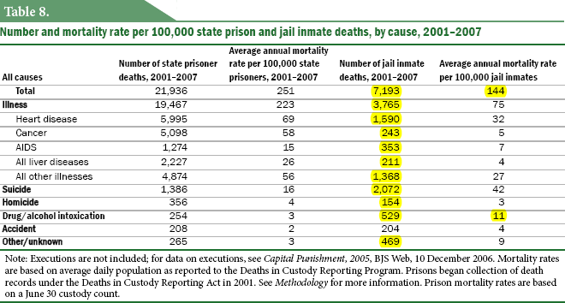
DCRP Mortality: Other Pops. (Prison)

Slide 15
DCRP Mortality: Other Pops (General)
The mortality rate is higher in the general population.
The top five causes of death in the general population are: heart disease, cancer, cerebrovascular disease, respiratory diseases and accidents.
The top five in local jails are (frequency): suicide, heart disease, intoxication, AIDS and cancer
Once adjusted for race and sex and age, suicide still occurs at a higher rate in jails than in the general population.

Slide 16
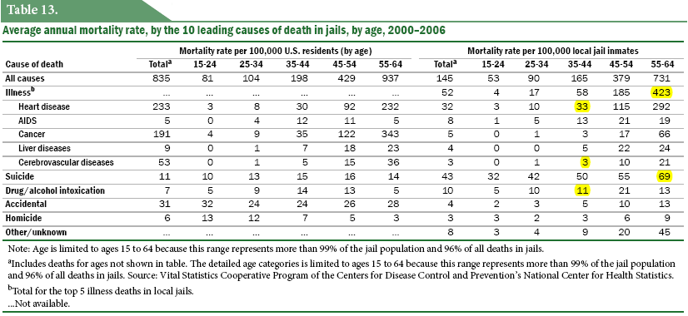
DCRP Mortality: Jail/Gen Pop Compare

Slide 17
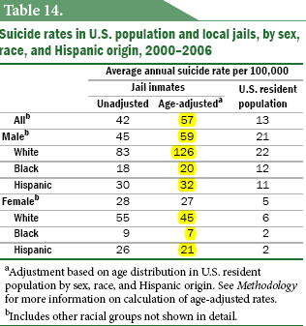
DCRP Mortality: Suicide Adjusted
What’s driving the higher suicide rates in local jails? White males.

Slide 18
DCRP Mortality: Potential Future Research
Mortality in ICE-run facilities
Mortality in similarly situated jails, i.e. grouping jails by the populations they serve
An update of the ‘Medical Causes in State Prison’ report

Slide 19
DCRP - Publications
Suicide and Homicide in State Prisons and Local Jails, 2000-2002
Medical Causes of Death in State Prisons, 2001-2004
Arrest-Related Deaths in the United States, 2003-2005
Deaths in Custody Statistical Tables (2000-2007)
Mortality in Local Jails, 2000-2007

Slide 20
DCRP Mortality: More information
BJS website: http://bjs.ojp.usdoj.gov/
Email: margaret.noonan@usdoj.gov

